Slide 1
What is the Raspberry Pi?
Has anyone used a Raspberry Pi before?

Slide 2
What is the Raspberry Pi?
Who is familiar with it?

Slide 3
What is the Raspberry Pi?
Who knows what makes it different than other computers?

Slide 4
Rule
Always ask questions!

Slide 5
Safety First!
Caution!
The Pi is realllllly fragile!

Slide 6
Safety First!
It can be easily messed up with an electrical shock

Slide 7
Safety First!
You can possibly get (lightly) shocked

Slide 8
Safety First!
(Advanced group)
Double check your wiring

Slide 9
Safety First!
The Pi is really fragile
It can be easily shocked
You can possibly get a shock
Double check your wiring

Slide 10
Safety First!
Questions?

Slide 11
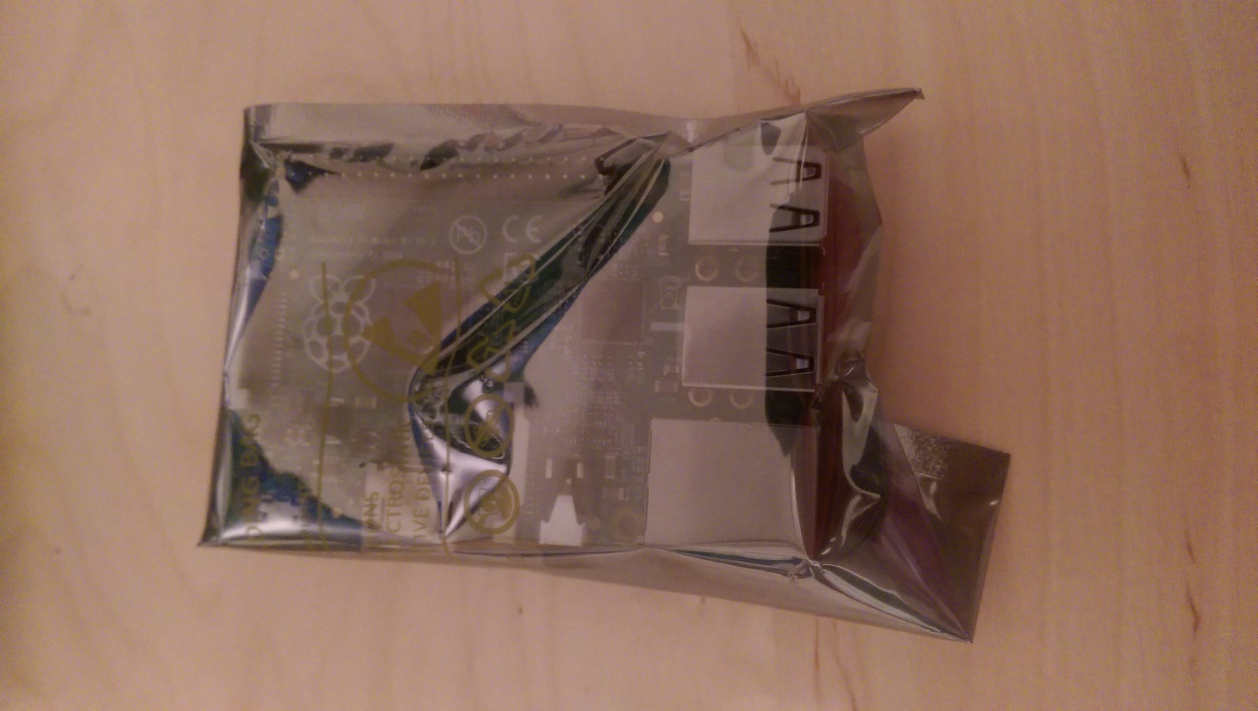
How to Hook It Up
Carefully take out of the wrapper (wrapper is anti-static)

Slide 12
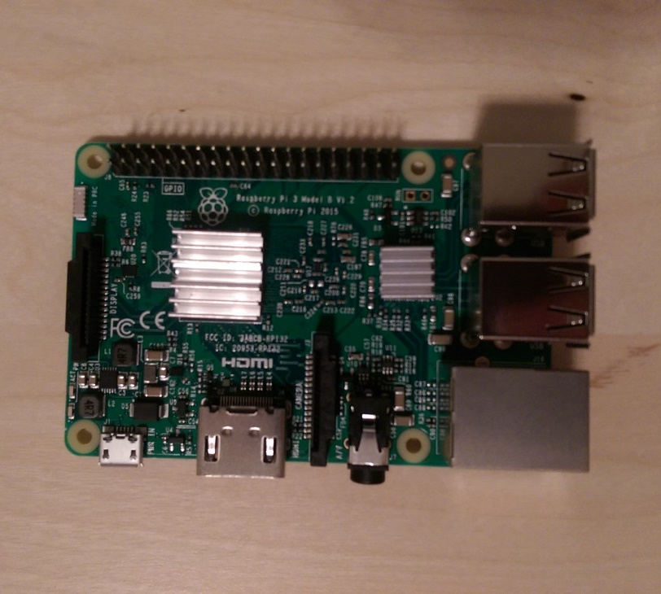
How to Hook It Up
Add heatsinks to black integrated circuits (only on top)

Slide 13
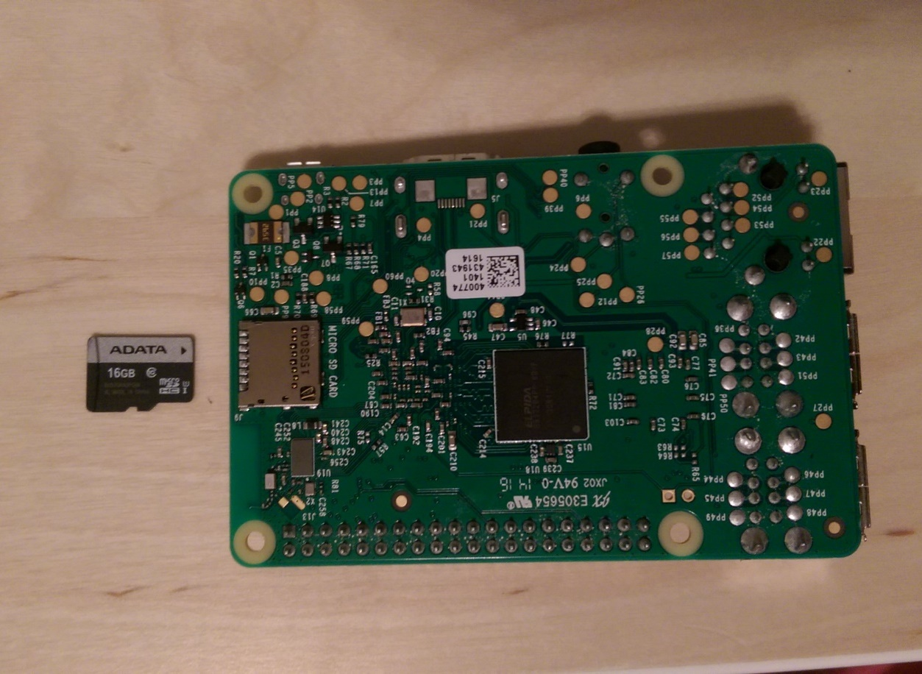
How to Hook It Up
Slide in micro SD card

Slide 14
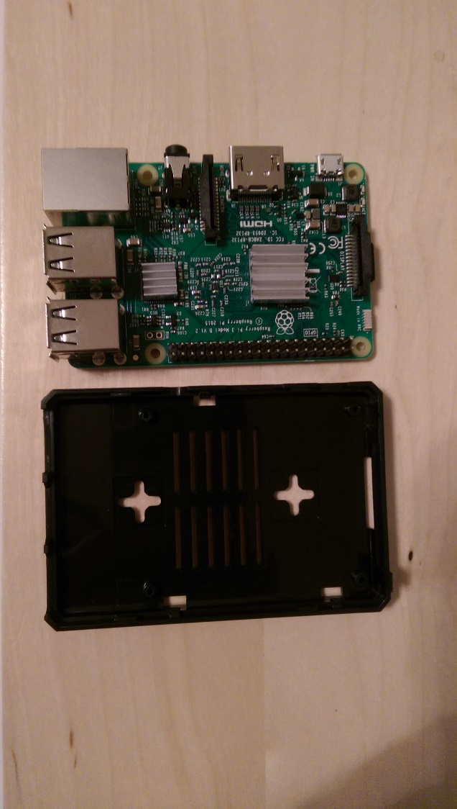
How to Hook It Up
Put it in the case

Slide 15
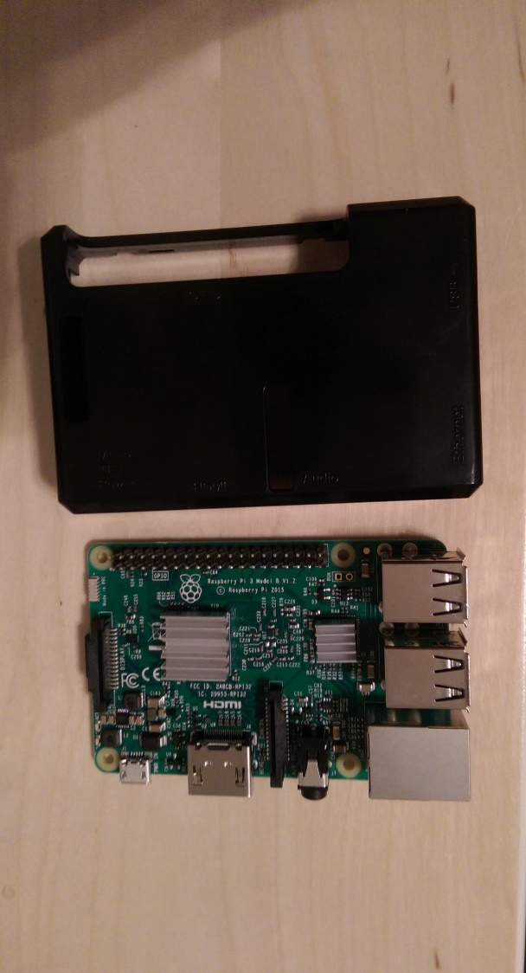
How to Hook It Up
Put it in the case

Slide 16
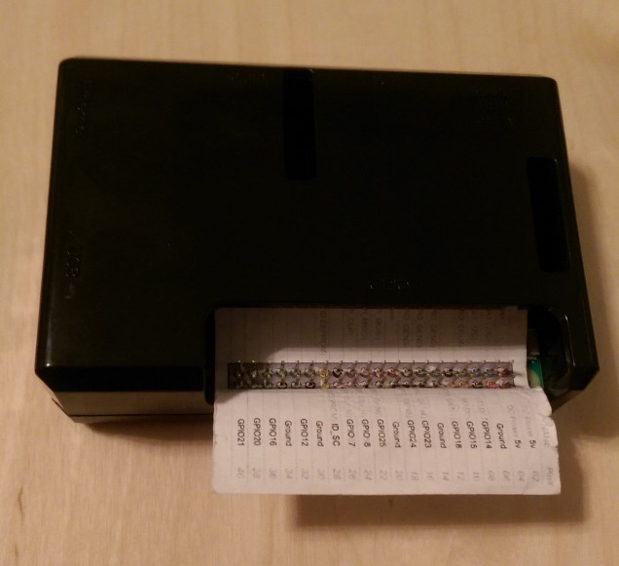
How to Hook It Up
Put the pin layout on the Pi (Red square towards the edge)

Slide 17
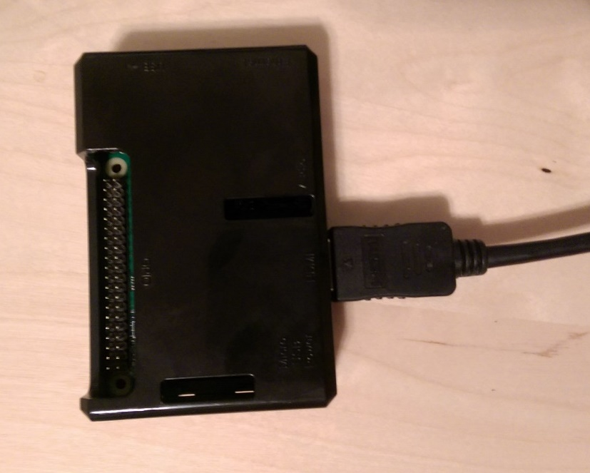
How to Hook It Up
Plug in the HDMI (TV) cable

Slide 18
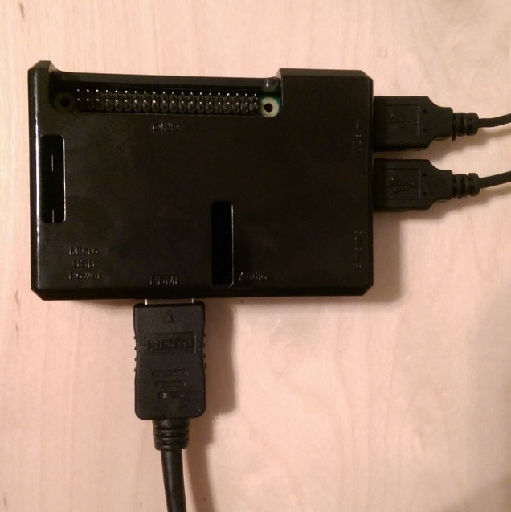
How to Hook It Up
Plug in keyboard and mouse

Slide 19
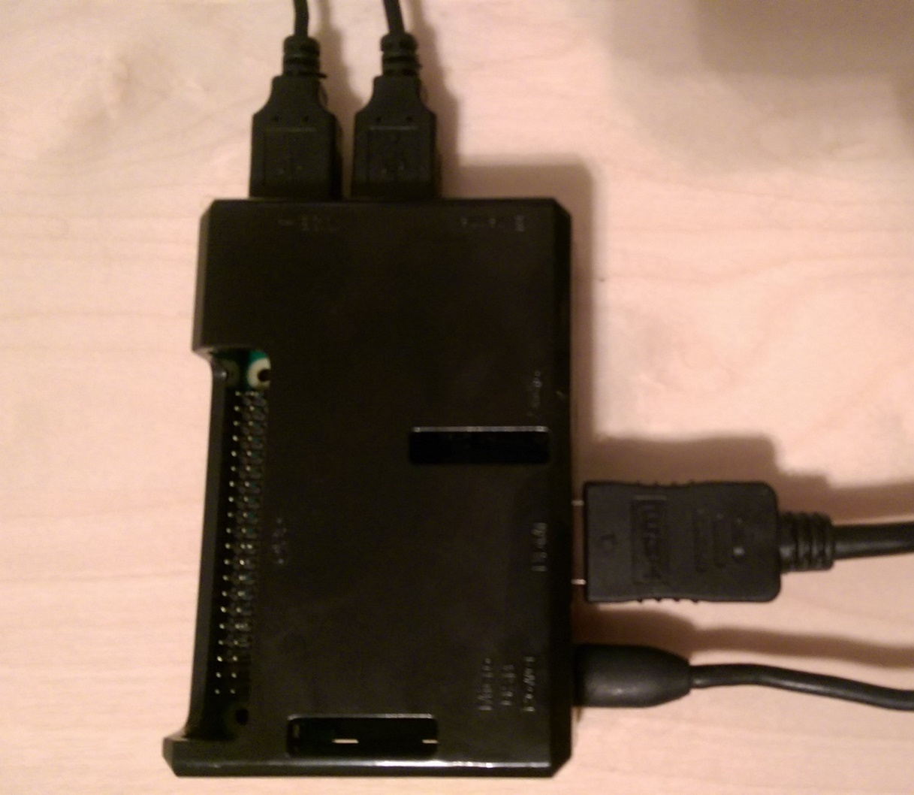
How to Hook It Up
Plug in the power cable (It will automatically turn on)

Slide 20
How to Hook It Up
Have fun!

Slide 21
Have fun!
Split up!
Beginners – Rachel Morris
Advanced – Sarah Withee

Slide 22
Hardware Pieces
You have a whole box of parts
We won’t use all of them today

Slide 23
Electricity Basics
You have a whole box of parts
We won’t use all of them today though

Slide 24
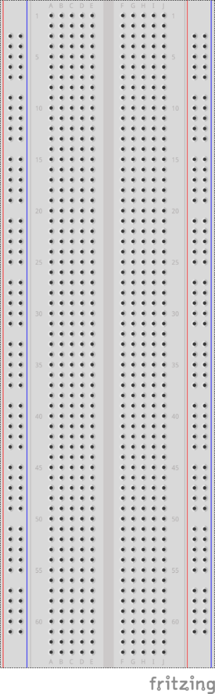
Electricity Basics
Breadboard
A type of board used for building and testing simple circuits

Slide 25
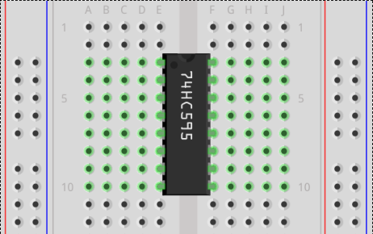
Electricity Basics
Each column of holes are connected together
The gap separates the rows
Each row of 5 holes are connected to each other
Blue column is typically Ground
Red column is typically Power
(5V or 3V)

Slide 26
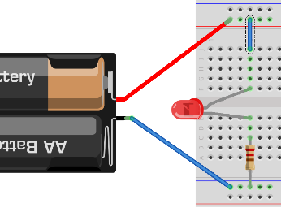
Electricity Basics
Electricity works in circuits
Electricity has to flow in a full loop

Slide 27
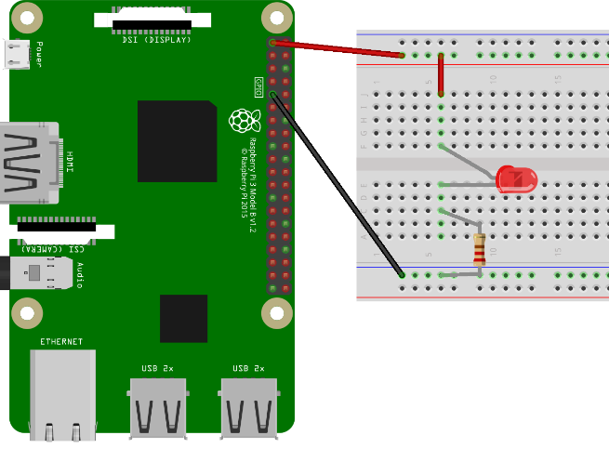
Electricity Basics
Pi can provide power to make circuits

Slide 28
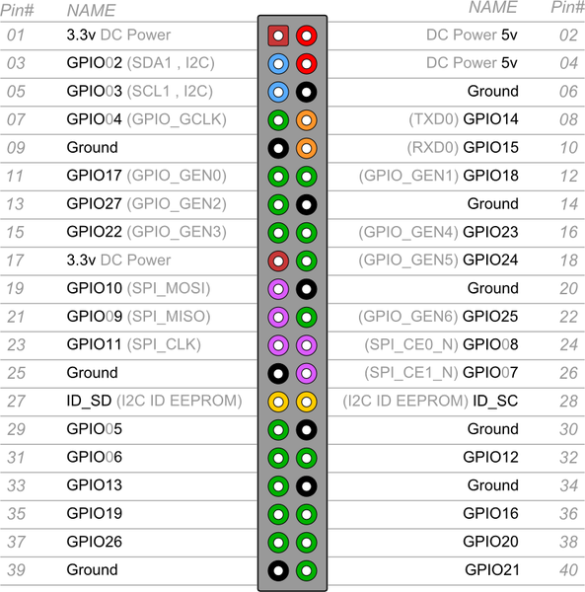
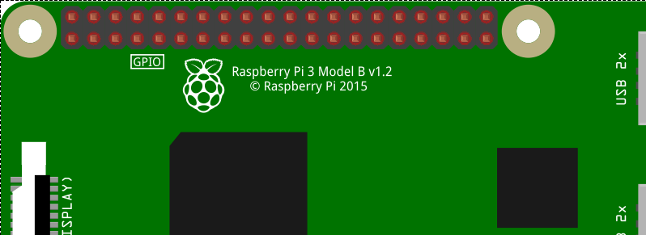
Electricity Basics
Each pin has a function
GPIO pins are what we can program to control things

Slide 29
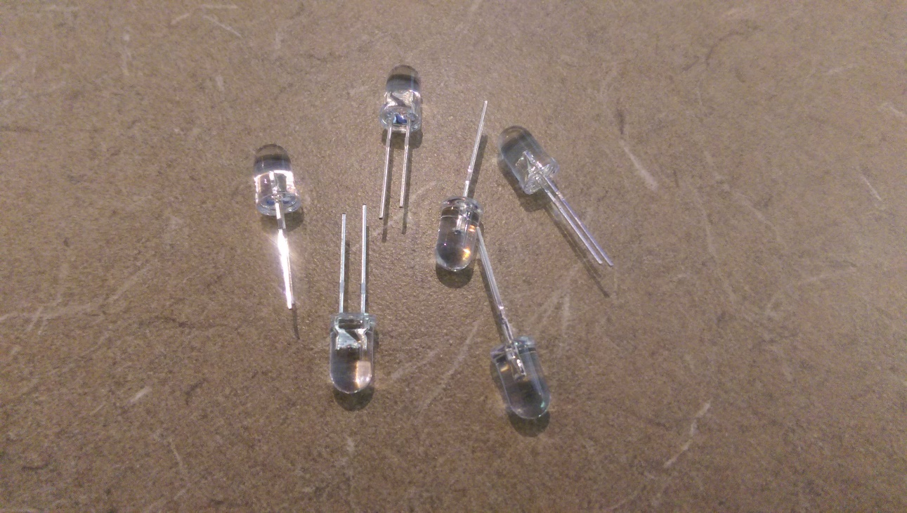
LEDs
Light Emitting Diodes
(like small lights)

Slide 30
LEDs
Long wire is positive (+)
Short wire is negative (-)
If you wire backward, it won’t turn on

Slide 31
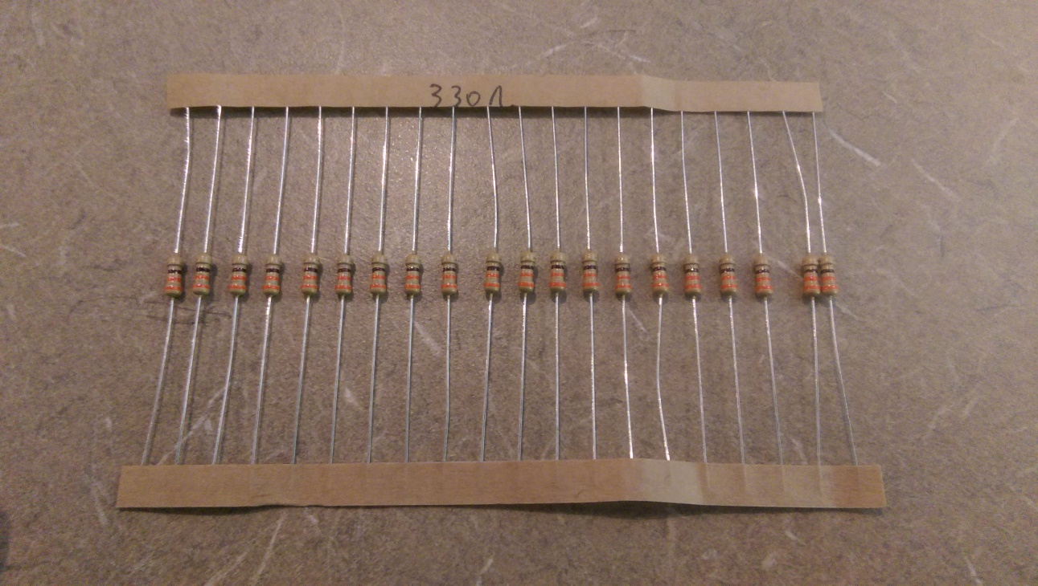
LEDs
Each LED circuit needs a resistor. It can go before or after it.
Your kit includes two types. Use the 330Ω ones with LEDs

Slide 32
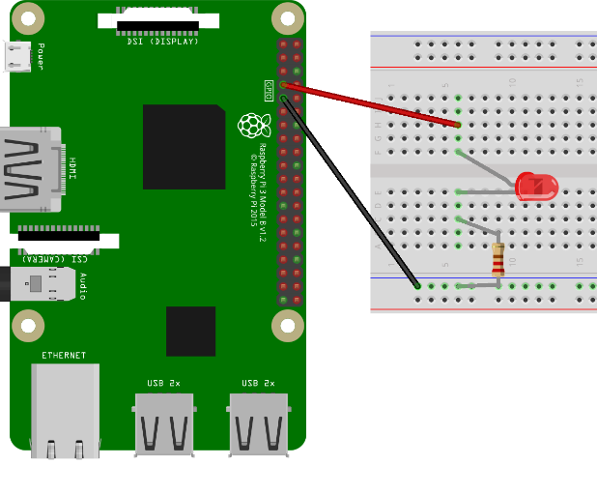
LEDs
Connect long wire to GPIO pin
Connect short wire to resistor
Connect resistor to Ground

Slide 33
LEDs
Coding time!

Slide 34
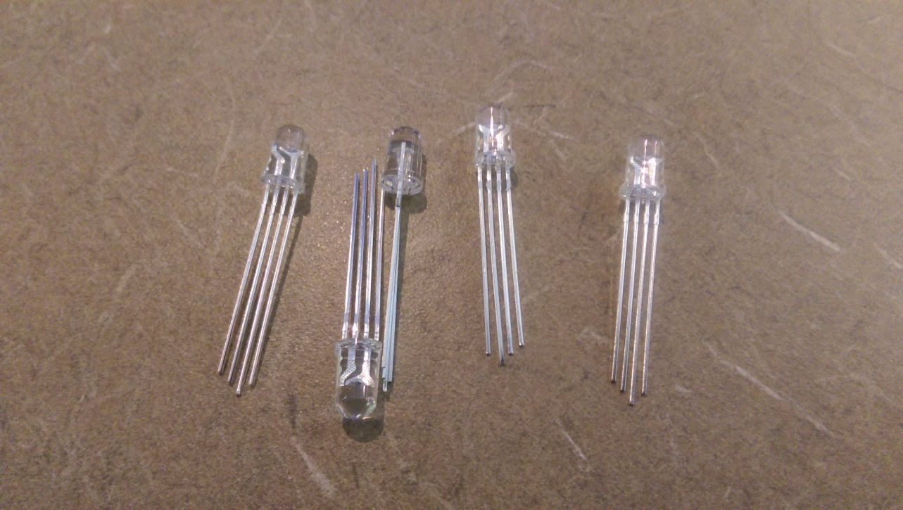
RGB LEDs
Red Green Blue LED
You can independently control the red, green, and blue parts to make any color

Slide 35
RGB LEDs
4 wires:
Longest: (-) ground
Other 3: (+) red, green blue

Slide 36
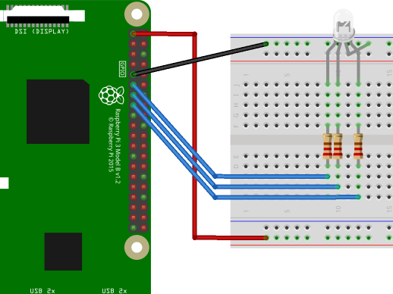
RGB LEDs
RGB LED long wire to ground
Ground line to GND pin
Other 3 wires to resistors
Resistors to GPIO pins

Slide 37
RGB LEDs
Coding time!

Slide 38
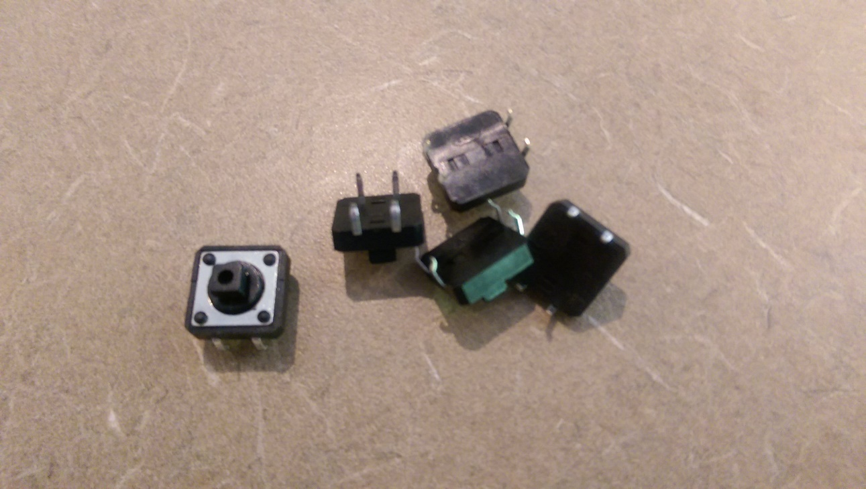
Switches
Switches complete a circuit when they are pressed down

Slide 39
Switches
Pins are curled to identify sides
Pins curled opposite directions are connected together
Pins curled same way are connected when switch is pushed

Slide 40
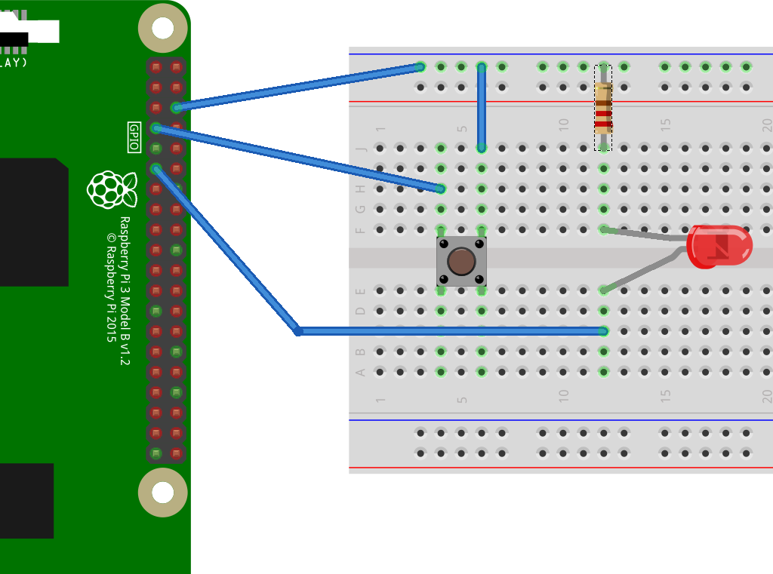
Switches
Press switch firmly down onto breadboard
Wire one curled side to GND, one to GPIO
Connect an LED as before

Slide 41
Switches
Coding time!

Slide 42
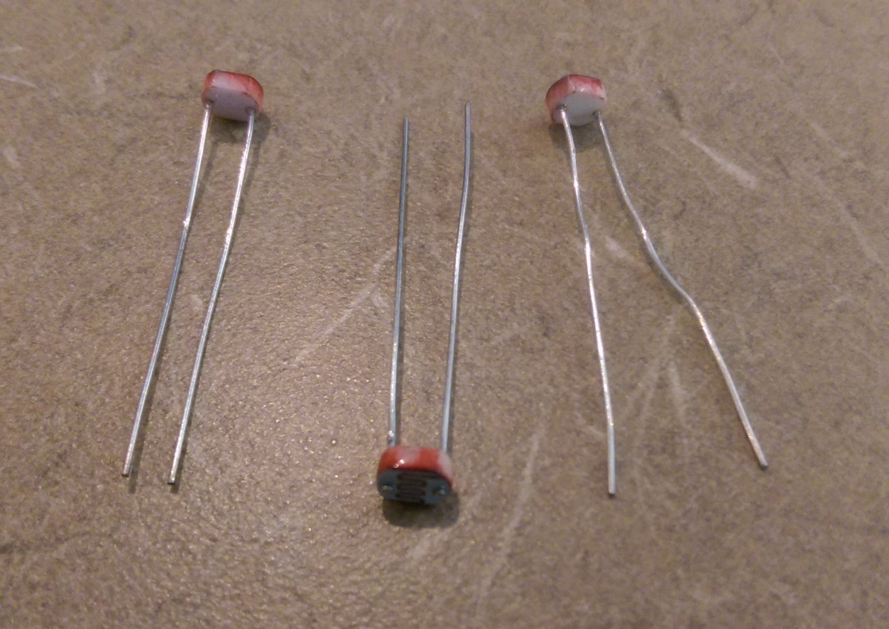
Photo Resistors
Photo resistors are like regular resistors
They change resistance based on amount of light they get

Slide 43
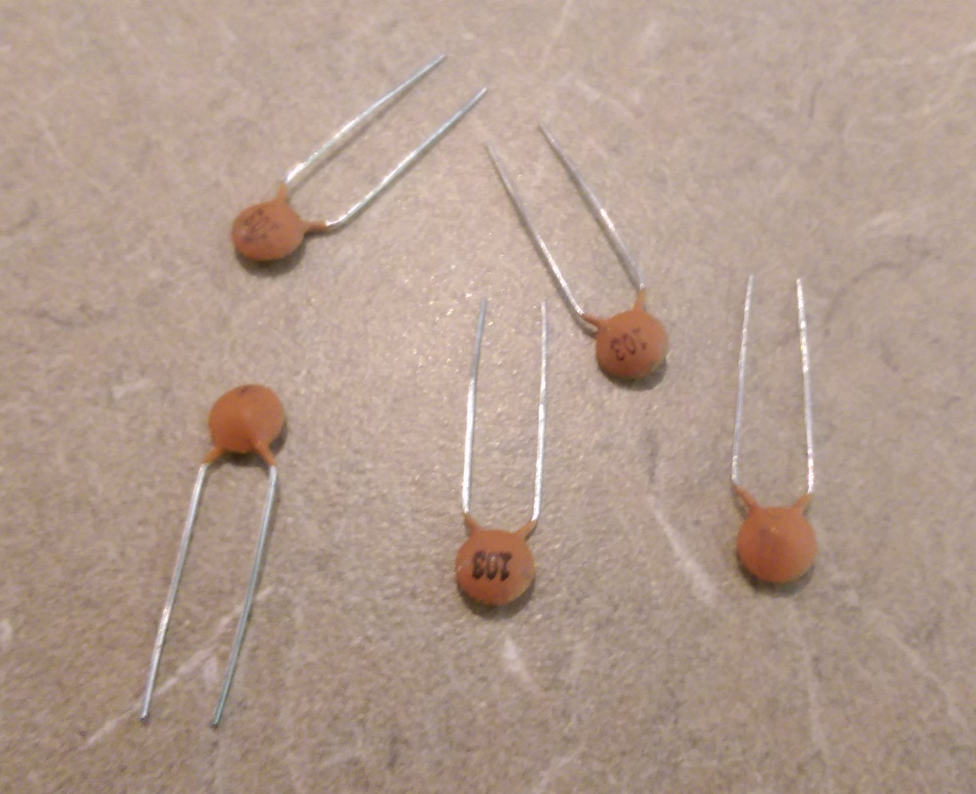
Photo Resistors
Capacitors store a little bit of charge (like a battery)
For this, we’ll use with the photoresistor

Slide 44
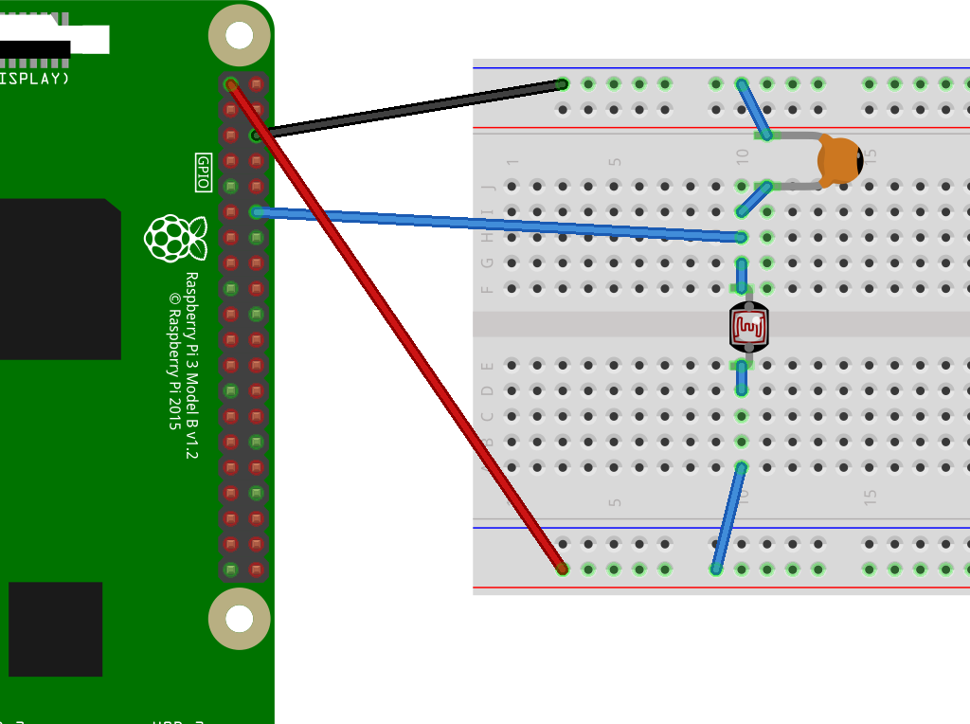
Photo Resistors
Connect: - 3.3V to red rail
- GND to blue rail
- Red rail to photoresist.
- Blue rail to capacitor
- Capacitor to photo.
- GPIO to cap/resis

Slide 45
Photo Resistors
Coding time!

